Slide 1

Foodies hub
1

Slide 2
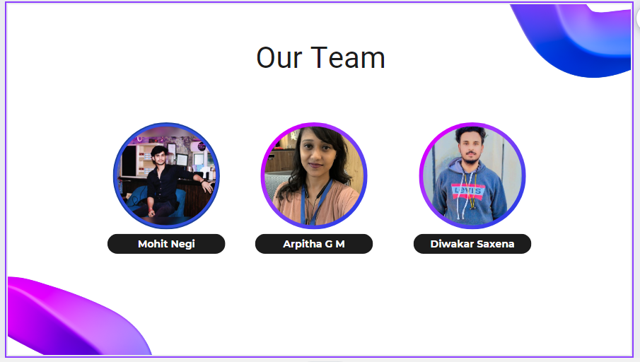
2

Slide 3


Slide 4
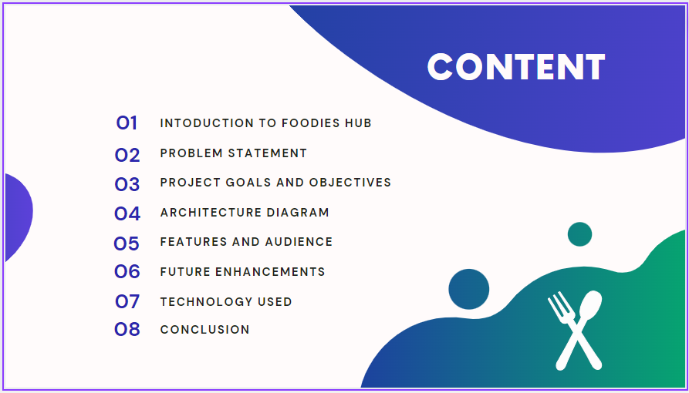
Foodies hub
4

Slide 5
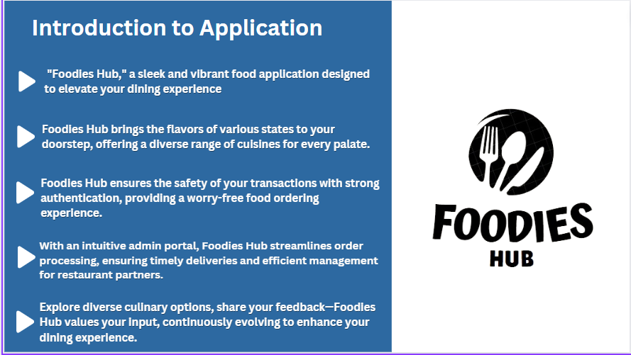
Foodies hub
5

Slide 6
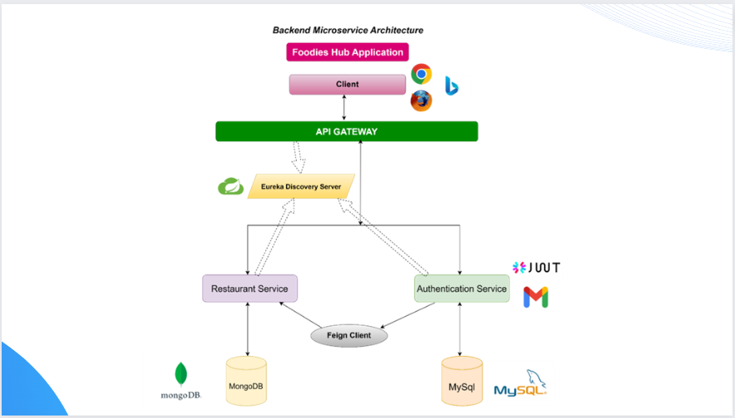
Foodies hub
6

Slide 7
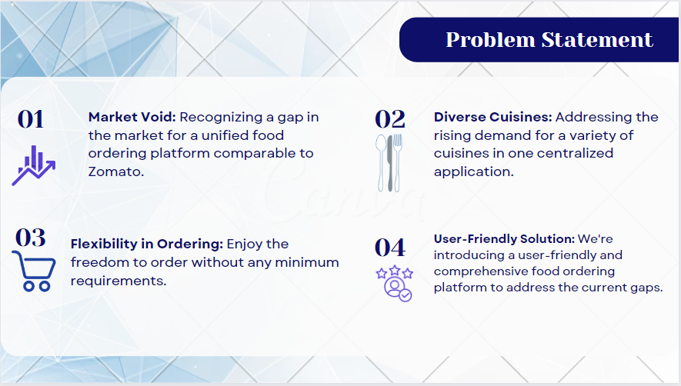
Foodies hub
7

Slide 8

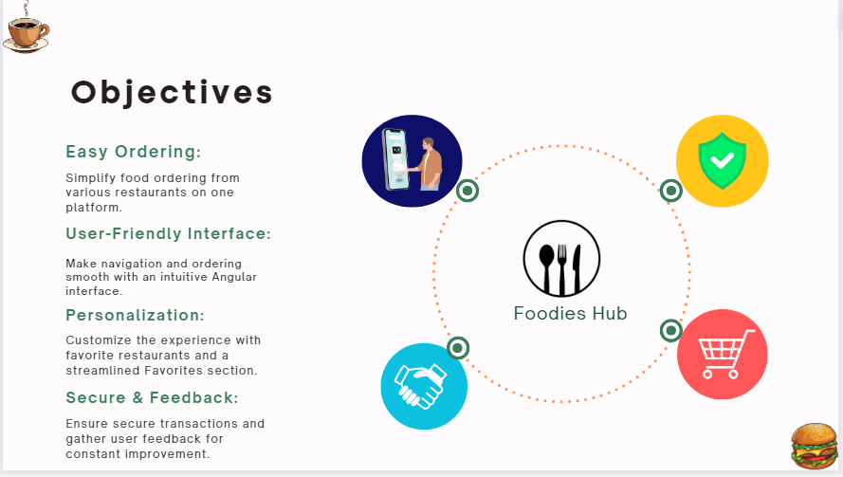
8

Slide 9

Foodies hub
9

Slide 10

Foodies hub
10

Slide 11

Foodies hub
11

Slide 12
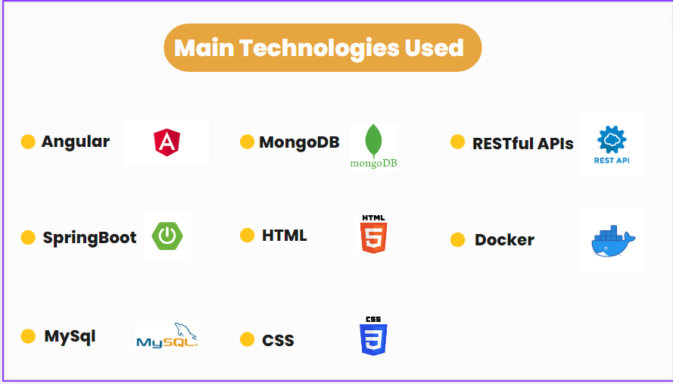
Foodies hub
12

Slide 13
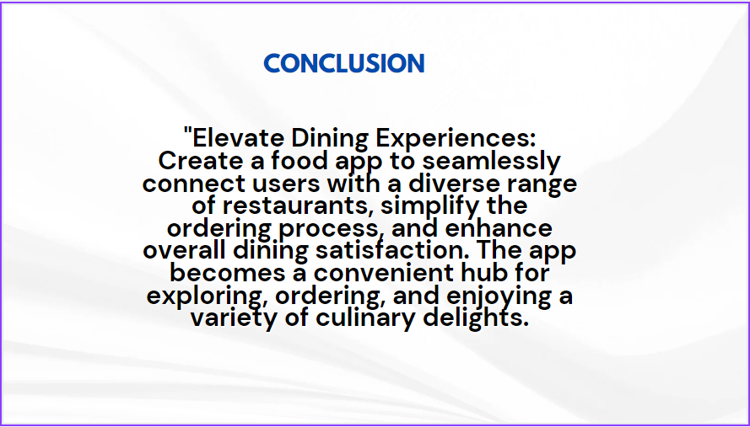
Foodies hub
13

Slide 14

Foodies hub
14

